Slide 1

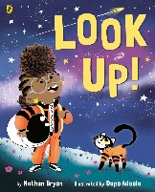
LOOK UP!
WRITTEN BY NATHAN BRYON ILLUSTRATED BY DAPO ADEOLA
3 . . . 2 . . . 1 . . . LIFT OFF. Let science-mad
chatterbox Rocket launch into your hearts
in this inspiring picture book.
Rocket's going to be the greatest astronaut,
star-catcher, space-traveller that has ever lived!
But... first, she needs to convince her big brother Jamal to stop looking down at his phone and
start LOOKING UP at the stars.

Slide 2
Looking at picture 1
Text &
Inference
Looking at picture 2
Design &
Illustration
Use an exclusive picture from Look Up! to improve pupils' inference skills, as well as get them excited about the story and characters.
INSPIRATION 1. This picture encourages pupils to think about the key theme in the story: that too many people are looking down at their phones instead of engaging with the world. As a preparatory activity, ask pupils to make a tally throughout the day of how many times they look up and down. Which one wins?
INSPIRATION 2. This picture also introduces the main characters in the story and their relationships. To get pupils thinking about relationships, ask them to think about and describe their own family dynamics. Who is the grumpiest in their household? Who is the most patient? Who always gets their own way!
Introduce pupils to the art of picture book design and illustration.
INSPIRATION 1. This picture encourages pupils to consider the power of illustration to convey a key message in the story: what stops people communicating and enjoying the world together? Why do people ignore each other? Ask pupils: have they ever spoken to a stranger in the street? Why or why not?
INSPIRATION 2. This picture expands on the idea of communication by including a speech bubble for an interior monologue. Ask pupils to experiment with designs of speech bubbles to show different things; how can they distinguish between inner thoughts and spoken words using design techniques?
Looking at picture 3
What happens next?
Activity Sheets
Ideas
This picture gives you a little glimpse into how the story ends. You’ll have to read the book to find out – but your pupils can use their imagination and everything they’ve learnt so far from the covers and pictures, to come up with their own ending!
After you’ve finished reading, spark imaginations by challenging pupils to design their own planets. There’s also some super cute activity sheets so you can colour in Rocket and draw your own cat.

Slide 3
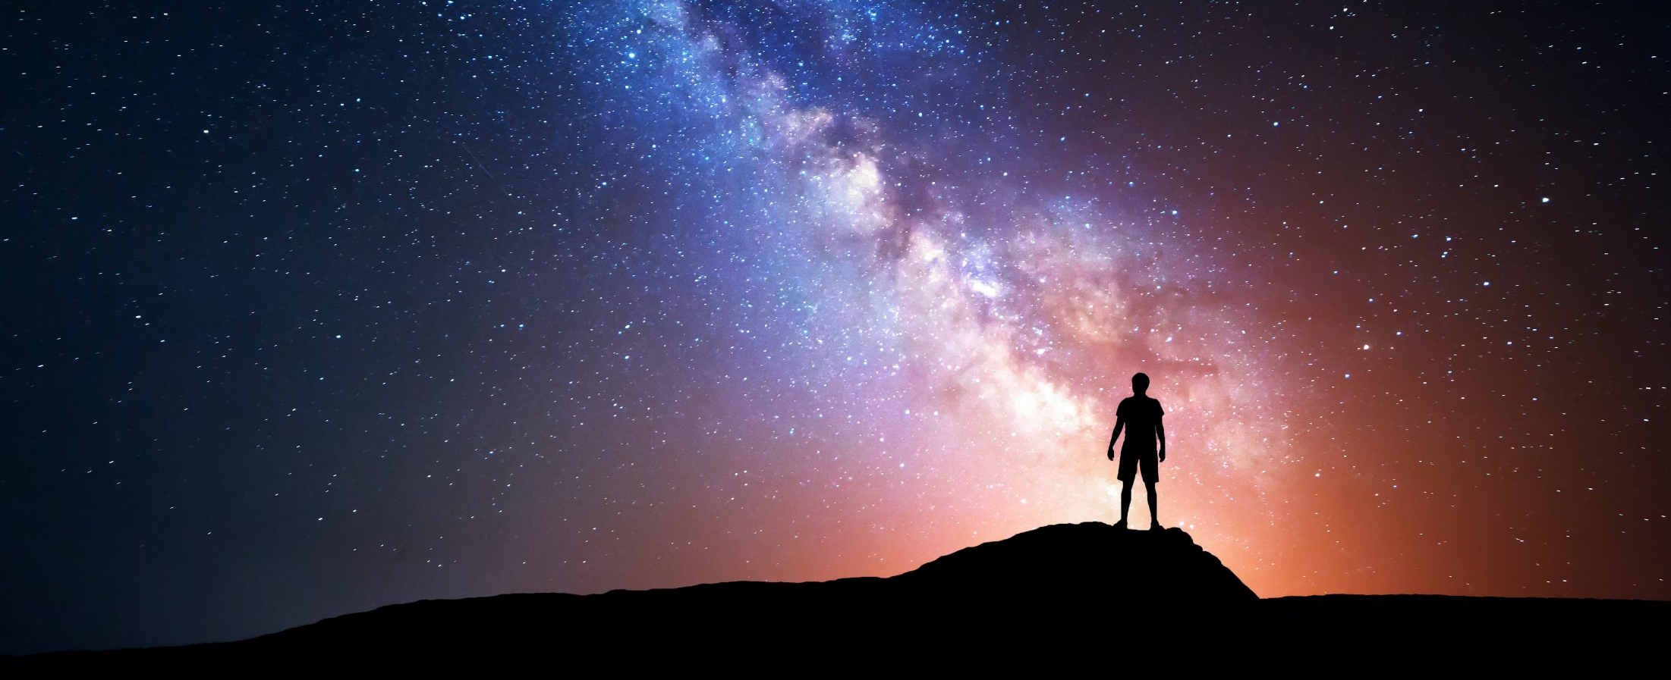
PROMPT IMAGE: WORD BANK
PROMPT IMAGE!
BEAUTY
UNIVERSE
ISOLATED
WONDROUS
UNKNOWN
SCALE
INTIMIDATED LONELY DISCONNECTED CONNECTED AMAZED
AWE
LIGHT SEPARATED
HOPEFUL
ASPIRATIONAL
DARK
NATURE

Slide 4
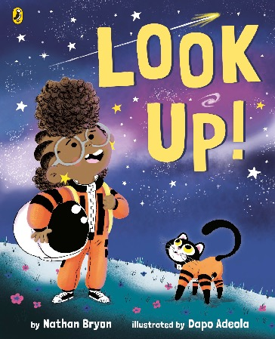
SENTENCE STARTERS
Cover clues
I can see the following different elements…………………………………
They tell me that…………………
I think the main character might be………………………………………
Other characters include……
I predict that most important ideas and themes in the story are……………………………………….

Slide 5
What can you tell about the book from each element?
Cover clues
1
2
3
4
Prompt questions
How is the text written? Is it big or small? What effect does this have?
Who is the main character? What can you tell about his/her personality and interests?
What other characters are present? What might their relationship be with the main character?
Consider what the objects pictured symbolise or represent. What do they make you think about?

Slide 6
PICTURE 1:
Text & Inference
BE A TEXT
DETECTIVE!
What does it mean if your head is ‘always floating in the clouds’? What sort of character is Rocket, judging from this description?
What is Rocket’s brother, Jamal, always doing? What can you tell about him from this?
What can you tell about the relationships between the three characters in this picture? How? Create a tableaux or freeze-frame showing the dynamic between Rocket, Jamal, and their mum. Who is most impatient? Who is most excited? Who is the calmest?

Slide 7
PICTURE 2:
Design & Illustration
BE A picture
book pro!
What are all of the people doing in the illustration? Which characters are not looking down? Why do you think the illustrator is trying to say?
Why do you think the illustrator has placed so many characters next to each other? What point is he trying to make?
What is the speech bubble used for? Who is Rocket talking to? Is anybody listening? Why or why not? Create a thought bubble for every character that you can see on the page. Then, imagine if they did speak to each other, what would they say? Would it be short or long dialogue?

Slide 8
PICTURE 3:
What happens next?

Slide 9
Dapo says . . .
challenge
Create a character by taking a friend or family member and drawing them as your favourite animal. Think about their facial expressions, mannerisms, dress sense and items of clothing when drawing the animal you’ve chosen.

Slide 10
Nathan says . . .
challenge
One by one go around the class adding one word
each to create a brand new story. Your teacher could start with ‘Once upon a time . . .’ and the story can
be as long or as short as you want!

