Slide 1

EARTH DAY! | GLOBAL CITIZENSHIP | LOOKING AFTER THE PLANET

Slide 2

What is Clean Up! About?
See what you can guess
from the cover
WHERE do you think it is set?
WHO do you think the main character is?
WHAT do you think her mission
in the story is?
Notes:
Introduce Clean Up! and its key themes. If children are unfamiliar with the story, encourage them to look at the cover to find clues about setting, characters, and plot. Outline the connection between the book’s themes and Earth Day – i.e. plastic pollution, sea creatures, environmental issues and how we can work together to make positive changes.

Slide 3

Clean Up! Is set in Jamaica! Rocket is excited to go on holiday to visit her Grammy and Grampy . . .
Take a moment: imagine in your head what the beaches look like in Jamaica. Share your picture with a partner. How blue is the sea? How golden is the sand? Can you walk along in your bare feet?
What do you know about Jamaica?
Where is it?
What is the climate like in Jamaica?
Notes:
Introduce the setting of Jamaica. Ask children to think about where Jamaica is, its climate and culture. Can they locate it on the world map? Then, encourage them to envision the beaches in the Jamaica – glowing blue water, golden sands etc.

Slide 4
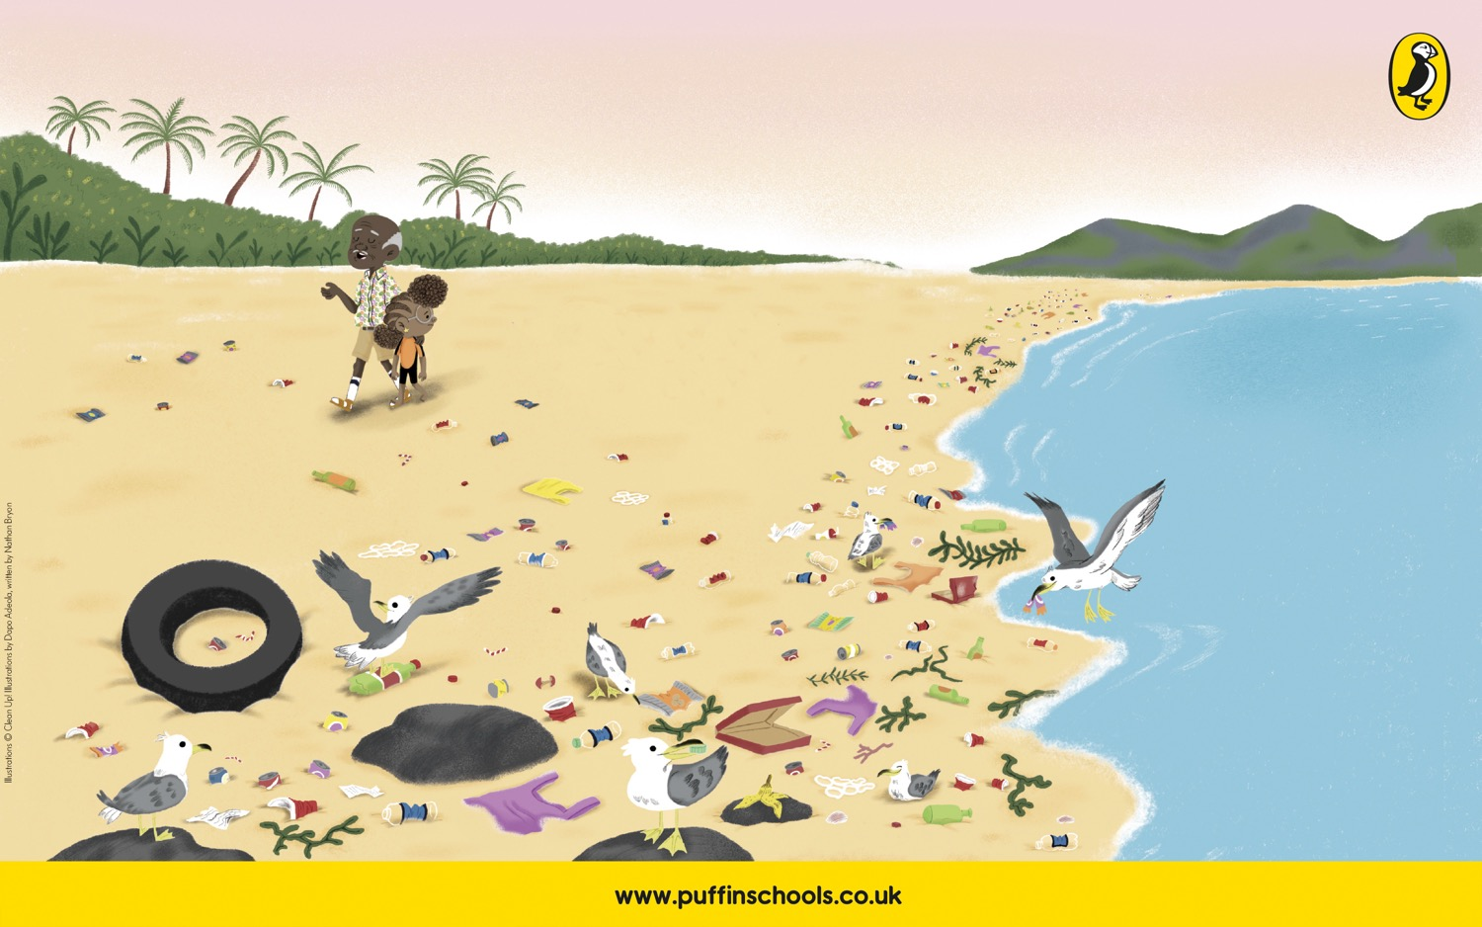
THIS is what Rocket finds on the beach in Jamaica . . .
Take a moment: What can you see? Is it different to what you imagined? How do you feel looking at this?
Notes:
Reveal what Rocket actually encounters on the beach: litter, rubbish, mountains of plastic. Facilitate short discussion: how does this make Rocket feel? How does it make the children feel?

Slide 5
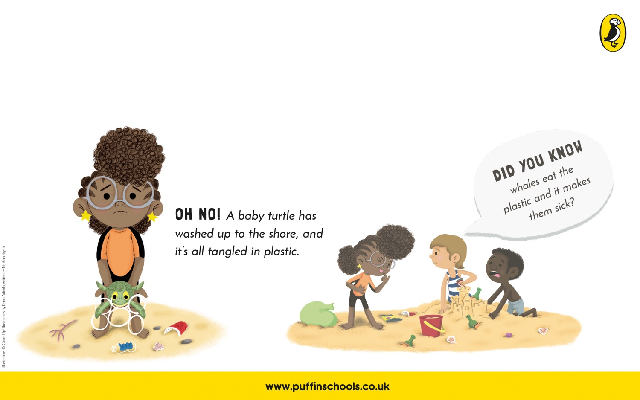
PLASTIC POLLUTION
What Rocket finds on the beach is known as . . .
What are some of THE EFFECTS of plastic pollution?
Notes:
Discuss some of the effects of plastic pollution that are explored in the book – i.e. sea creatures (e.g. turtles) become entangled and can’t swim, or creatures (e.g. whales) eat the plastic and become sick. Encourage students to discuss the domino effect of this. What impact does it have on the ocean’s eco-system? What impact does it have on us? Lead students to think about the big problems we face, e.g. species extinction and climate change.

Slide 6
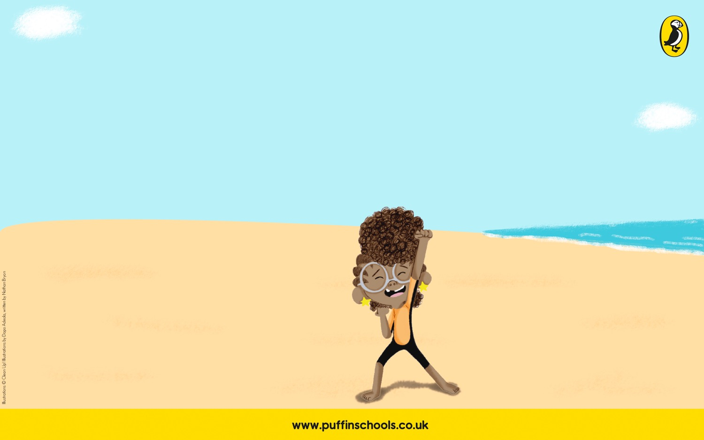
STAND UP and MAKE A DIFFERENCE
Rocket makes a decision. She must:
She has empathy for the sea creatures who are affected by the plastic pollution.
She persuades other humans to listen to her and change their behaviour.
She assembles a ‘clean-up crew’ to clean the beach.
She recycles the waste by helping to create some brand-new bins from it!
Thanks to Rocket
Small changes
can make a
BIG
difference
Notes:
Consider how Rocket makes a difference in the story by first showing empathy to the ocean and the creatures that live there – then, organising a clean-up of the beach, recycling the waste, and bringing people together in a common cause. Re-iterate the main message of the story and of the assembly: small changes can make a BIG difference. We still have hope as long as young people like Rocket are passionate about the Earth.

Slide 7

Watch Nathan talk about earth day – why it is so important, and how does it link to the themes in his story?
Look out for his answers to the following questions:
What is Earth Day?
How are the themes in Clean Up! Linked to Earth Day?
Why does Nathan care about this day?
Notes:
This is an opportunity to watch Nathan’s short video wishing the students a Happy Earth Day and talking about what the day means to him.

Slide 8
Now it's your turn!
What Global issues are YOU passionate about this EARTH DAY?
What do you know about the different environmental issues below?
How do you feel about them?
FOOD WASTE
FINDING SUSTAINABLE ENERGY SOURCES
PROTECTING WILDLIFE
PROTECTING OCEANS
GLOBAL WARMING
PLASTIC POLLUTION
WATER SHORTAGES
Notes:
It’s time for children to discuss their own passions. How have they been inspired by Rocket’s story? What do they most want to change in the word this Earth Day? Encourage them to think about some key environmental issues and the small steps they can take to make positive changes.

Slide 9

How will YOU follow in Rocket's footsteps to make a difference?
Rocket says: CLEAN UP!
What do YOU say?
Notes:
What would their environmental “motto” or “mantra” be?

Slide 10

“We need to do something!”
"One day you are going to change the World."
“There are over 5.25 trillion pieces of plastic in the ocean.”
“Plastic is ruining these islands.”
Notes:
Give time for children to reflect on the assembly. What have they learned? Encourage them to follow in Rocket’s footsteps – to take away their ideas, passions and ideas and turn them into action plans.

Slide 11

SMALL CHANGES MAKE A
BIG
DIFFERENCE.
Remember . . .
Notes:
Get them feeling inspired, and wish them a very happy Earth Day 2021, from Nathan and all of the Puffin team!

